Slide 1
IMAGE SEGMENTATION 2.0

Slide 2
General Segmentation Issues
Semantic segmentation faces an inherent tension between semantics and location
Global information resolves what while local information resolves where.
Deep feature hierarchies jointly encode location and semantics in a local-to-global pyramid.
We define a novel “skip” architecture to combine deep, coarse, semantic information and shallow, fine, appearance information.
Downsampling causes information loss, particularly around edges / boundaries
Downsampling results in coarse spatial output from input image (eg : 8x, 16x, 32x)

Slide 3
Types of Convolutions

Slide 4
Commonly used Convolutions in segmentation
Normal convolution
1x1 convolution
Atrous convolution
Transposed convolution / Deconvolution
Depth-wise separable convolution

Slide 5
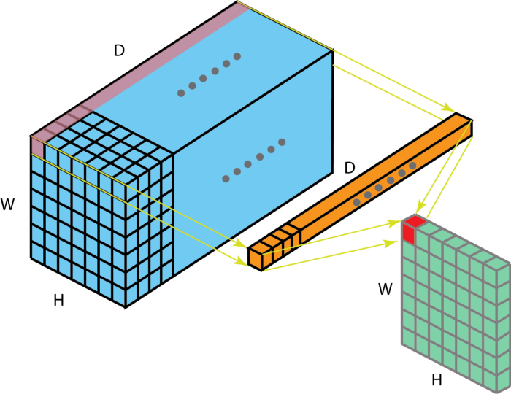
1x1 convolution
5x5x256 -> 5x5x32 embeds 256 channels to 32 channels.
Feature aggregator/pooling / low dimensional embedding version
Advantages
Dimensionality reduction for efficient computations
Efficient low dimensional embedding / feature pooling
Applying nonlinearity again after convolution
Reference
Convolution Arithmetic Paper

Slide 6
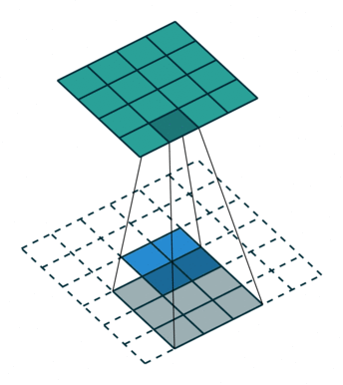
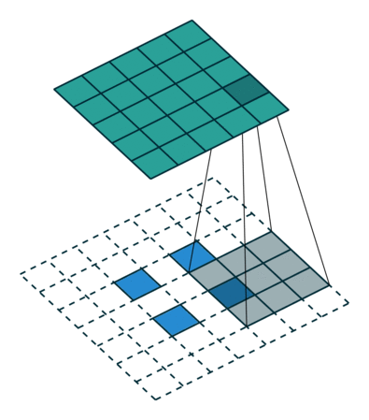
Transposed convolutions
Upsampling technique with learnable parameters
Reverse of normal convolution - Going from smaller input image to larger output image
Can have padding / no-padding
A guide to convolution arithmetic for deep learning
Input : 2X2, S=1, P=2, Output : 5x5, Z=1
Input : 2X2, S=1, P=2, Output : 4x4, Z=0
Image reference

Slide 7
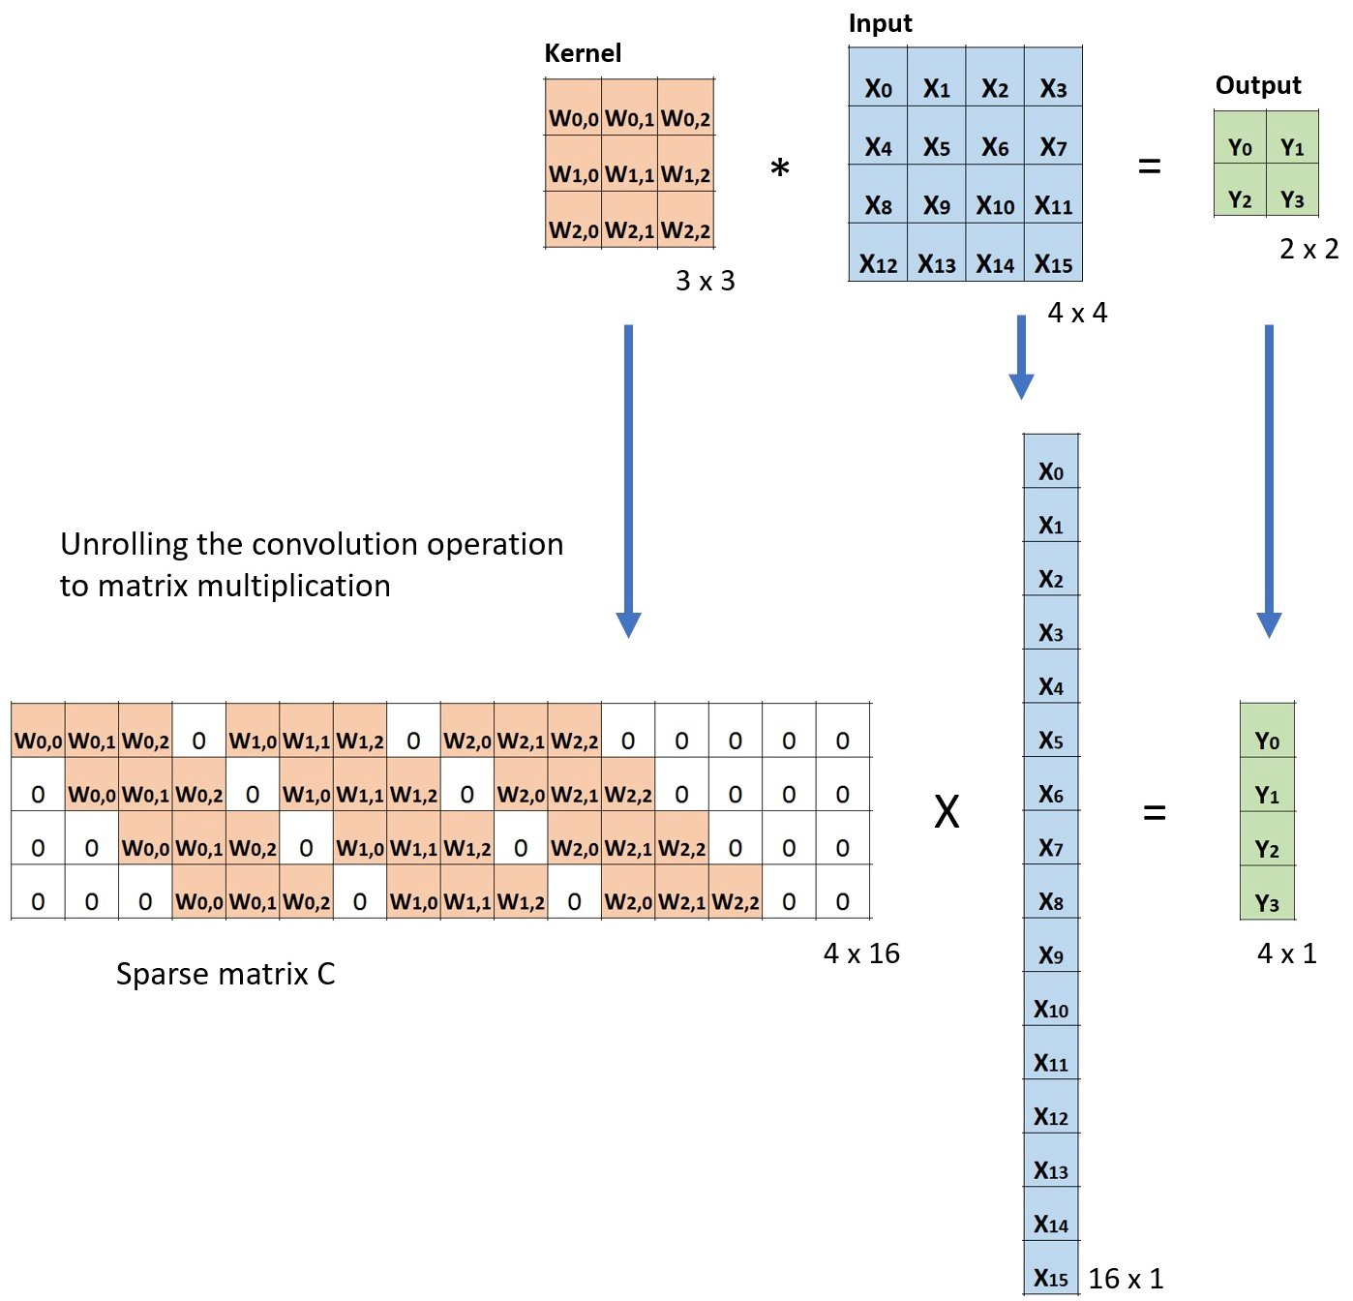
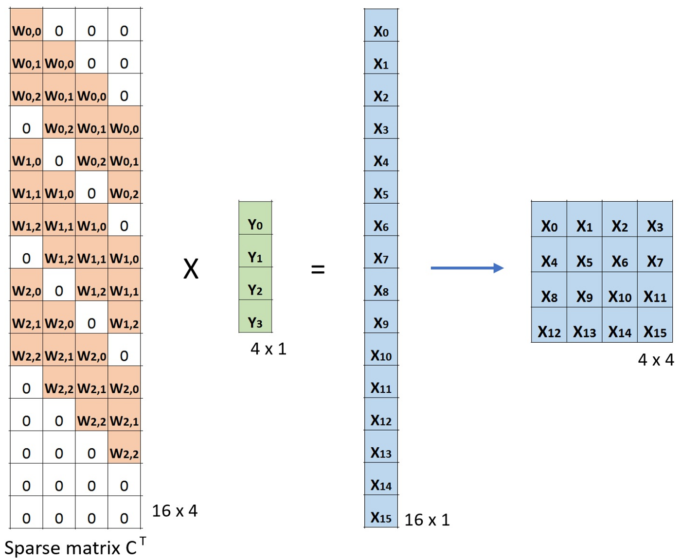
Normal convolutions
Transposed convolutions
Image reference

Slide 8
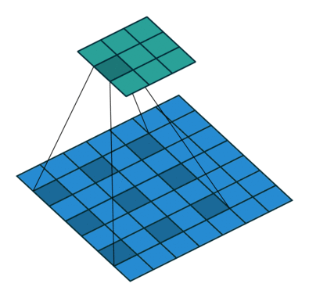
Atrous convolution
Dilated convolutions “inflate” the kernel by inserting spaces between the kernel elements.
Dilation rate indicates how much we want to widen the kernel
Advantages
Cheaply increase the receptive field of output units without increasing the kernel size, which is especially effective when multiple dilated convolutions are stacked one after another
Systematically aggregate multi-scale contextual information without losing resolution
Image reference

Slide 9
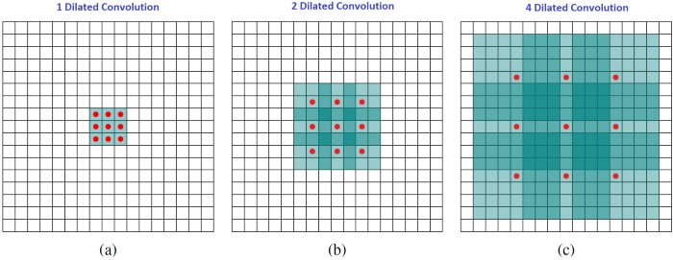
Atrous convolution
Multi-scale context aggregation by dilated convolutions

Slide 10
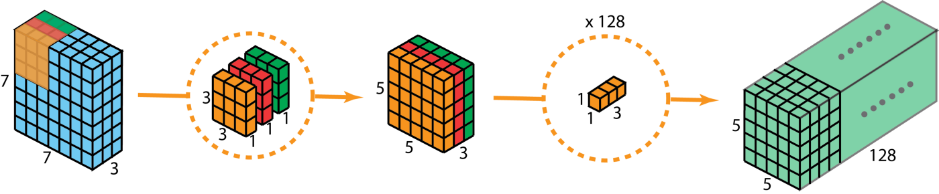
Depthwise Separable convolutions
Depthwise + Pointwise convolutions
Pioneered in Mobilenet, Xception
Advantages
<< Less number of parameters
Efficient to get similar performance at less FLOPs
Image reference

Slide 11
References for types of convolutions
Medium post on different types of convolutions in DL
Separable convolutions intro
Arithmetic on convolutions arXiv paper
NPTEL lecture on Atrous convolutions and Transposed convolutions
Pytorch Upsample docs
torch nn functional interpolate
Deconvolution and checkerboard artifacts blog post
How to use upsampling in pytorch gitpost
Upsampling SO post
Functional.interpolate vs nn.Upsample Pytorch forum

Slide 12
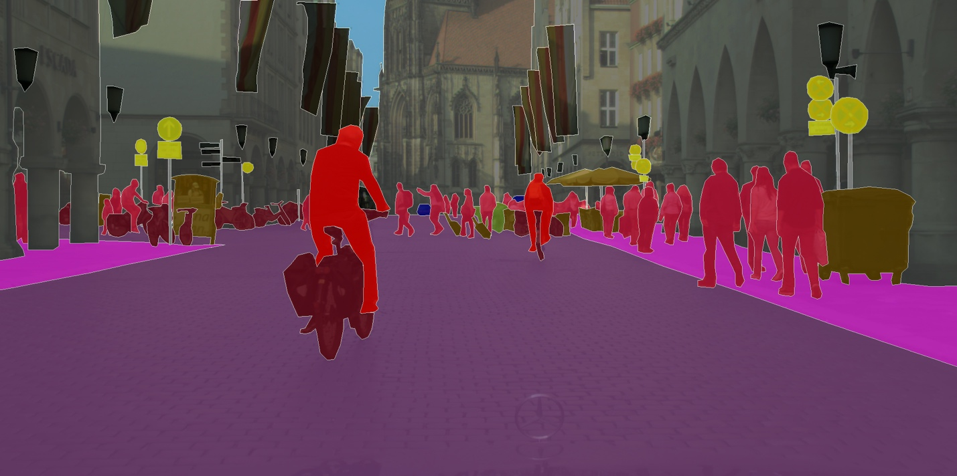
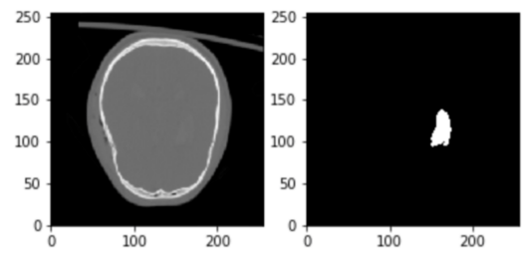
Loss functions in Semantic Segmentation
Semantic segmentation datasets -> generally imbalanced
Background class dominance / Rare but important classes. Eg : lampposts, bicycle etc
Loss function must be able to handle class imbalance
Similar in medical image processing too
Image reference
Image reference

Slide 13
Loss functions in Semantic Segmentation
Loss function | Use case
Binary Cross-Entropy | Works best in equal data distribution among classes scenarios
Multi-class Cross entropy | Multi-class version with option for weights for different classes
Focal Loss | Highly-imbalanced dataset, down-weight the contribution of easy examples, enabling model to learn hard examples
Dice Loss | Inspired from Dice Coefficient, a metric to evaluate segmentation results. Suitable for very imbalanced datasets too
Tversky Loss | Variant of Dice Coefficient. Add weight to False positives and False negatives.
Focal Tversky Loss | Variant of Tversky loss with focus on hard examples
Reference

Slide 14
Loss functions in Semantic Segmentation
Survey of Loss functions for Semantic segmentation
Segmentation models pytorch loss functions
Blog post on loss functions for semantic segmentation
Focal and Dice loss comparison
Focal Loss for Semantic segmentation
Loss functions Pytorch implementation

Slide 15
Segmentation Architectures

Slide 16
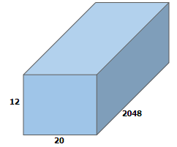
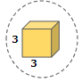
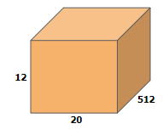
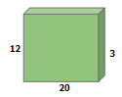
FCN (Fully Convolutional networks)
BACKBONE OUTPUT
CLASSIFIER HEAD

Slide 17
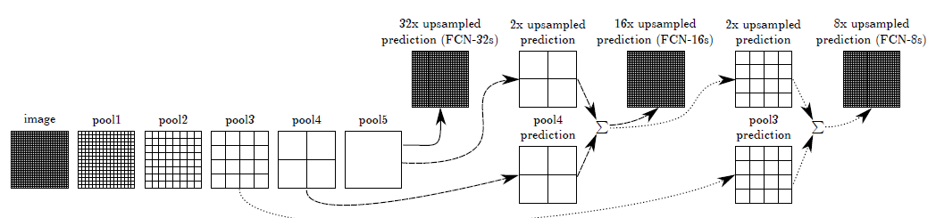
FCN (Fully Convolutional networks)
First network to propose end to end training for segmentation
Replaced classification network fc layers with conv layers, hence can accept arbitrary input size
No post / preprocessing methods.
Use VGG16, GoogLeNet and AlexNet backbones with final layers modified to output n-class channels. Latest versions use resnet backbones (fcn_resnet50 or fcn_resnet101)
Originally used 1x1 convolutions with transposed convolutions after backbone to give 32x downsampled image
VGGNet with skip connections to get FCN-16 and FCN-8

Slide 18
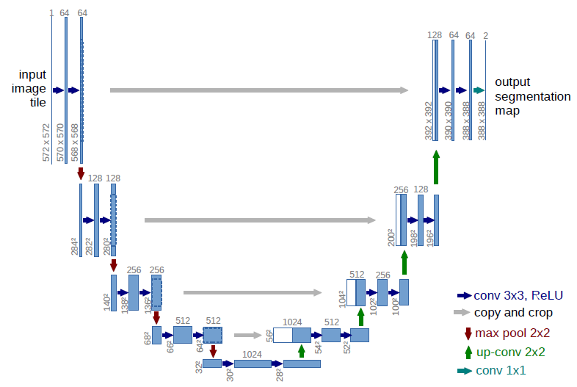
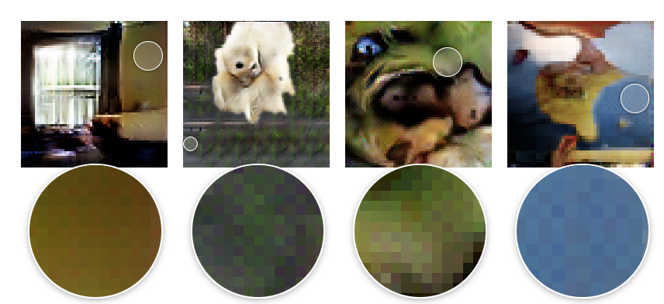
UNet
Popular in Medical image segmentation
Pioneered Encoder-Decoder architecture
Skip-connections to improve boundary prediction
Extensive use of data augmentation
Weighted loss function to counter class imbalance
Learned upsampling (Transposed convolutions)
Transposed convolutions introduces checkerboard like artifacts - Distill blog post

Slide 19
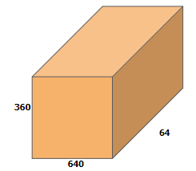
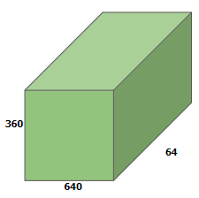
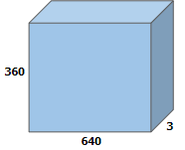
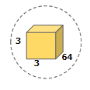
UNet - Double Conv block

Slide 20
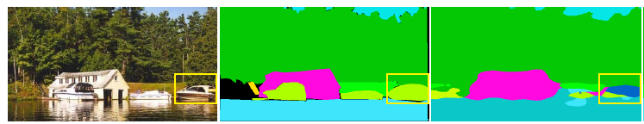
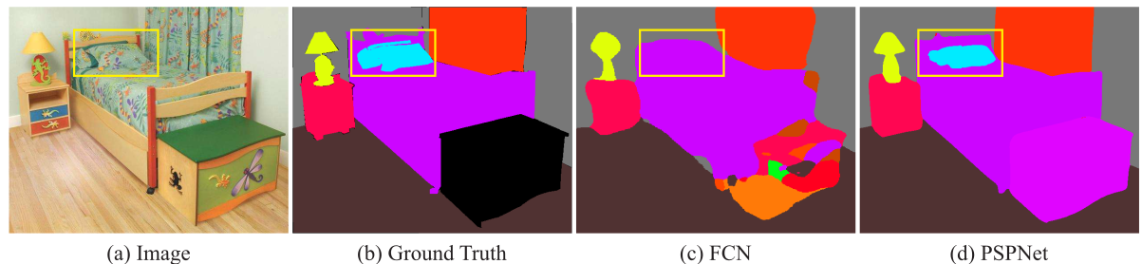
PSPNet
Objects present at Multi scale features at various distances / depths
Important to recognizing objects of different scale is critical
Global context prior of scene crucial to identifying object semantics
Global context prior importance - from PSPNet paper
Confusion b/w class having less samples- from PSPNet paper

Slide 21
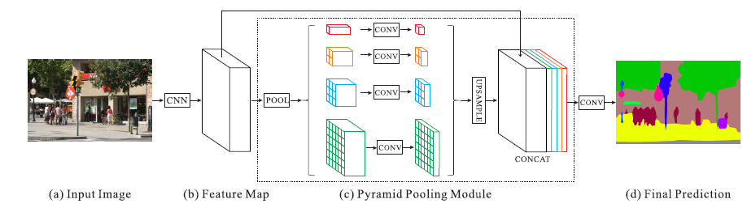
PSPNet
Solves Global Prior context and different scales using Pyramid Pooling Module
Pyramid Pooling Module helps capture Multi-scale context from single image using pooling operation
PSPNet Architecture

Slide 22
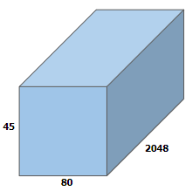
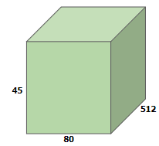
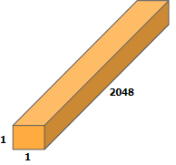
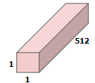
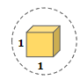
Spatial Pyramid Pooling
1x1 conv
Avg Pooling
Bilinear upsampling
Backbone output

Slide 23
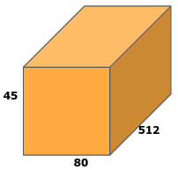
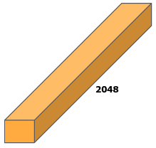
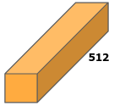
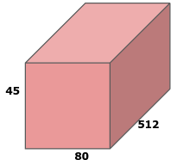
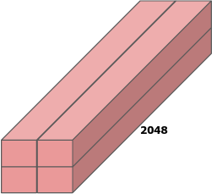
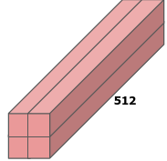
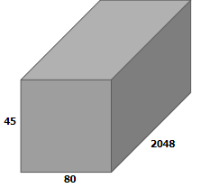
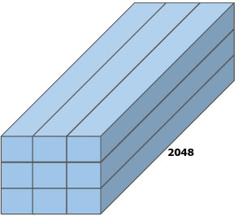
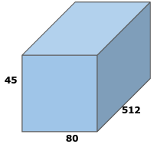
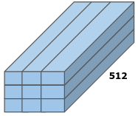
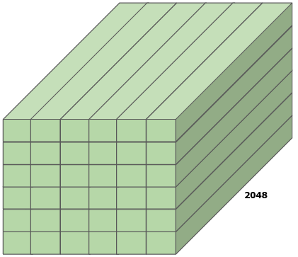
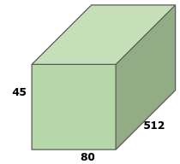
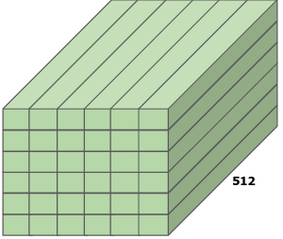
Pyramid Pooling Module

Slide 24
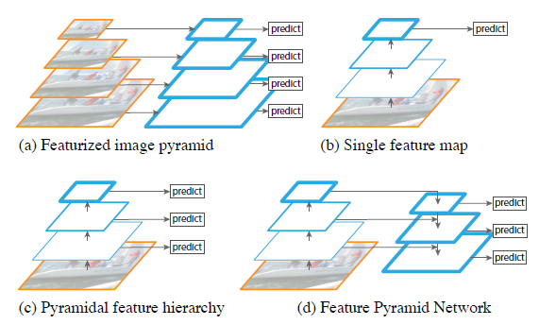
Feature Pyramid - extensible to Object Detection
Object Detection faces similar problem of multi-scale objects and context resolving pooling operation
Feature Pyramid Networks (FPN) based models core to solution
Feature Pyramid Network paper

Slide 25
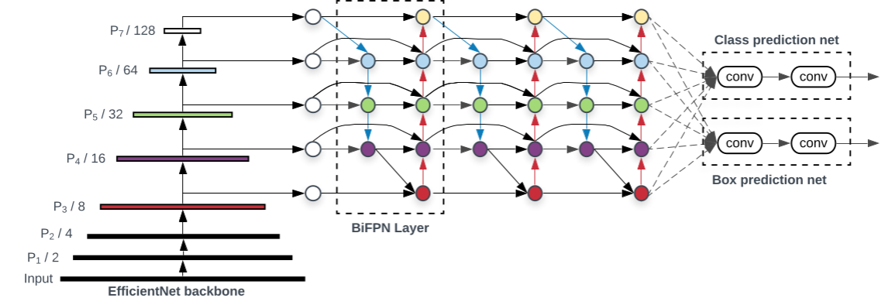
Feature Pyramid - extensible to Object Detection
BiFPN is a weighted bi-directional feature pyramid network proposed in the EfficientDet paper. Main improvements over FPN :
After the top-down feature fusion, it does fusion again from the bottom-up.
When fusing features, BiFPN observes that since different input features are different resolutions, they usually contribute to the output feature unequally. So they add an additional weight for each input.
Reference Medium post
BiFPN module in EfficientDet - Scalable and Efficient Object Detection

Slide 26
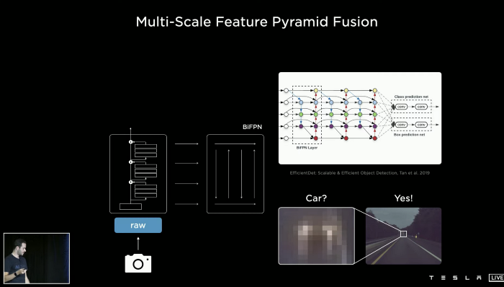
Feature Pyramid - extensible to Object Detection
Tesla uses improved version of FPN -> BiFPN
Original BiFPN uses EfficientNet backbone, Tesla uses RegNet. But idea is same : Combine feature maps of different resolutions to identify multi-scale objects
Tesla AI presentation

Slide 27
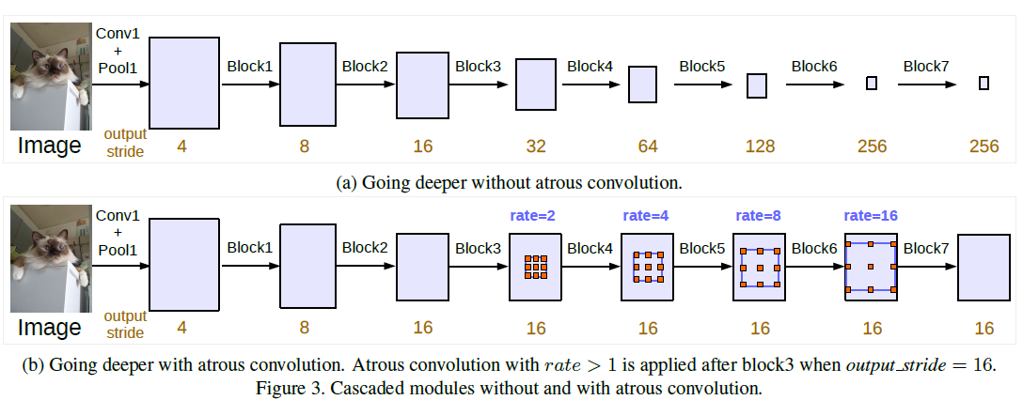
Deeplab V3
Deeplabv3 tries to address 2 main problems:
Decreasing resolution of feature map at each stage of model
Multi-scale object resolution
It does so using Atrous / Dilated convolutions in the feature backbone (Resnet / Xception)
Atrous convolutions - Deeplabv3 paper

Slide 28
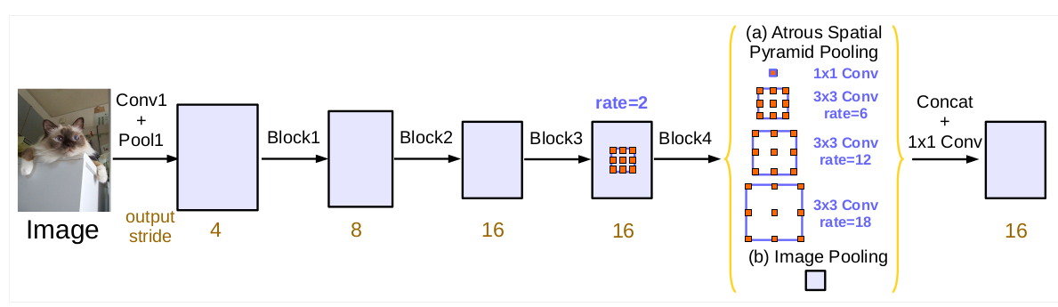
Deeplab V3 architecture
Deeplabv3 also uses the Spatial Pyramid Pooling like in PSPNet but with Atrous convolutions
Different dilation rates allow to capture different scales of features w/0 additional parameters
Deeplabv3 paper

Slide 29
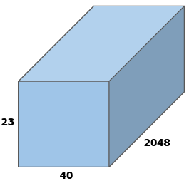
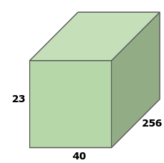
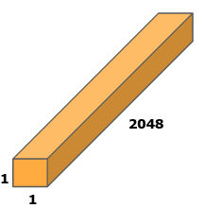


ASPP Pooling
Backbone output
Avg Pooling
1x1 conv
Bilinear upsampling

Slide 30


ASPP Conv
Backbone output
3x3 Conv (rate=12)
ASPP Conv Output

Slide 31

Deeplab V3+ architecture
Deeplab V3+ makes use of two architectures:
Encoder Decoder = Offers crisp boundary prediction and is faster
ASPP = Multi-scale features and flexible to modify
Deeplabv3+ paper

Slide 32

Deeplab V3+ with Xception backbone
Deeplab V3+ propose modified Xception backbone to Resnet
Uses Atrous Depth-wise convolutions combining better efficiency of Xception and flexibility of Atrous convolutions
Deeplabv3+ paper

Slide 33
Segformer - Transformer

Slide 34


Encoder decoder in NLP

Slide 35
Attention in NLP
w1
w2
w3

Slide 36

Encoder Decoder without Attention
Encoder Decoder with Attention

Slide 37


Self Attention

Slide 38


Query, Key and Value

Slide 39

Efficient Self-Attention
(255, 0,0)
0.0 | 0.0 | 0.0
0.33 | 0.33 | 0.33
0.0 | 0.0 | 0.0
(0,0,255)
(255, 0,0)
(0,255,0)
(255, 0,0)
(0,255,0)
(0,0,255)

Slide 40

Dot product attention intuition

Slide 41

Multi head Self-Attention

Slide 42

Multi head Self-Attention

Slide 43
Multi head Self-Attention
head1
head2
head3

Slide 44

Transformer architecture

Slide 45
References Transformer
Intuitive explanation with great visualisations - Illustrated transformer
Visual explain mathematical operations - Visual guide to transformers and self attention
Andrew Ng Attention model notes
Dot product visualisation
Pytorch implementation of Transformer - Seq2Seq Attention model
Mathematical behind transformers - Lennart Svenson lectures
End to end training of transformer in Pytorch - Harvard NLP post

Slide 46

Vision Transformer
Transformers on images = Vision Transformer
Images separated into patches and each patch ~= word in sentence
Position encoding to represent order of sequence
No Encoder - Decoder split. After Encoder, just MLP module as per target Task

Slide 47

Segformer Architecture
Encoder-decoder version of Vision Transformer, for segmentation tasks
Multi-scale problem tackled by feeding encoder outputs at different stages to decoder
Decoder is simple MLP which combines multi-scale encoder outputs

Slide 48
Mix Transformer
Mix Transformer stage 1
Mix Transformer stage 2
Mix Transformer stage 3
Mix Transformer stage 4
Efficient self attention
Efficient self attention
Efficient self attention
Efficient self attention
Overlap patch merging (7,4)
Mix FFN
Overlap patch merging (3,2)
Mix FFN
Overlap patch merging (3,2)
Mix FFN
Overlap patch merging (3,2)
Mix FFN
3
4
18
3

Slide 49

Segformer - Overlap Patch Merging

Slide 50


Segformer - Overlap Patch Merging

Slide 51
Efficient Self-Attention
Query
64
1
4096
64
Key
1
64
Dot product
Attention
1
64
Value
64
1
Attention * value
Output
64
1
1

Slide 52







Mix FeedForward Network
Reshape to (c,h,w)
Depthwise separable conv
Mix FFN Input
FC1
FC1 output
FC2 output
FC2
Reshaped to (hw,c)

Slide 53



Mix Transformer
Mix Transformer Stage consists of
Overlap Patch embedding
N number of Transformer blocks
Image reference

Slide 54














Stage outputs
Unify channels
Upsample
MLP
Decoder
Concatenate
Linear fuse
Project n_classes

Slide 55

Panoptic Segformer
Image reference

Slide 56

Visualizing Transformer Attention
Dino library
Visual guide to Attention Math of Intelligence YT video
exploring explainability of vision transformer
lucid rains vit pytorch
Transformer explainability git repo
Self-attention video generation

Slide 57



Visualizing Transformer Attention
Query (64, 128, 256)
Key (64, 16, 32)
Attention (32768, 32)
*
=

Slide 58
Intuition of Transformers in CV
In segmentation,we're trying to build classes together. So attention will try to group similar classes together, car with car and tree with tree . If depth estimation, pixels containing relevant features will have more weights.
Helps identify related context at location. If you’re looking for car, what is related parts in the entire images
Query and key are two different spaces (key is more abstract feature map), how to group low level features to get more meaningful vut abstract feature. Attention serves as bridge
Attention intuition - Andrej Karpathy Tesla AI video 2021 from 58:00 to 01:03 5 minutes
Different types of attention

Slide 59
Pytorch Segmentation Libraries
pytorch segmentation library - Pytorch Library with pretrained models, Dataset utils, Tensorboard integration, LR Schedulers etc
segmentation models pytorch - Segmentation models with pretrained backbones
pytorch-semseg library
sssegmentation pytorch library
libtorch segmentation C++ library
Mmsegmentation library
Einops Python library
PointRend-Pytorch

Slide 60
Research papers
A guide to convolution arithmetic for deep learning
EfficientDet - Scalable and efficient object Detection
Deeplabv3
Deeplabv3+
Multi-Scale Context Aggregation by Dilated Convolutions
Fully Convolutional Networks for Semantic Segmentation
Feature Pyramid Networks for Object Detection
Image Segmentation Using Deep Learning: A Survey
Pyramid Scene Parsing Network
SegFormer: Simple and Efficient Design for Semantic Segmentation with Transformers
Attention Is All You Need
Transformers in Vision: A Survey
U-Net: Convolutional Networks for Biomedical Image Segmentation
AN IMAGE IS WORTH 16X16 WORDS: TRANSFORMERS FOR IMAGE RECOGNITION AT SCALE
PointRend - Image segmentation as rendering

Slide 61




Segmentation Applications
Autonomous vehicles
Fashion Industry
Medical Imaging
Agricultural AI

Slide 62





Deep Learning Project Components
Dataset
Hyperparameters
Loss function
Model
Metric

Slide 63
Backup slides

Slide 64
FCN (Fully Convolutional networks)
3
12
3
12
3
12
2048
3
512
3
20
20
20
Backbone output

Slide 65
Double Conv
360
3
360
360
3
64
64
64
3
640
640
640
Backbone output

Slide 66
Spatial Pyramid Pooling
512
1
1
2048
1
45
1
2048
1
1
80
45
512
Backbone output
80

Slide 67
ASPP Pooling
512
1
1
2048
1
23
1
2048
1
1
40
23
512
Backbone output
40

Slide 68




Slide 71
2048
512
45
512
45
80
2048
80
512
45
2048
512
80

Slide 72
512
2048
45
512
80
45
2048
512
512
80

Slide 73
2048
512
45
512
80

Slide 74
ASPP Pooling
1
256
2048
23
23
1
1
1
256
2048
1
1
40
40
1x1 conv
Bilinear upsampling
Backbone output
Avg Pooling

Slide 75
ASPP Conv
23
23
2048
3x3 Conv
(rate=12)
256
40
40
Backbone output

Slide 76


ASPP Conv
256
23
23
1
256
2048
1
40
40
1x1 conv
Bilinear upsampling
Backbone output
Avg Pooling

Slide 77
Mix Feedforward
64
256
4096
64
4096
256
64
64
4096
256
4096

Slide 78
Decoder part1
64
64
64
64
256
256
64
64
64
32
32
64
128
256
256
32
32
64

Slide 79
Decoder part2
16
16
64
320
256
256
16
16
64
512
256
64
8
8
256
8
8
64

Slide 80
Decoder part3
1024
64
64
256
64
64
64
3
64

Slide 81
Mix Transformer
Mix Transformer Stage consists of
Overlap Patch embedding
N number of Transformer blocks
Image reference

